Slide 1
Image Classification with Convolutional Neural Networks
Final Project - Introduction to Deep Learning
Student: Mor Greenberg
Dataset: Alpaca vs. Not Alpaca
GitHub

Slide 2
Problem Definition & Dataset
Task: Binary image classification
(Alpaca vs. Not Alpaca)
Dataset size: 327 images total
Training: 262 images
Validation: 65 images
Image preprocessing:
Resize to 224×224
Normalization using ImageNet statistics
Challenge:
Small dataset size
High risk of overfitting

Slide 3
Part 1-
Experimental Setup - Training from Scratch
Framework: PyTorch (no fastai)
Baseline approach:
Training CNNs from scratch on the target dataset
Evaluation:
Training vs. validation accuracy
Training vs. validation loss curves
Controlled experiments:
Same dataset split
Same number of epochs
Fair comparison between models

Slide 4
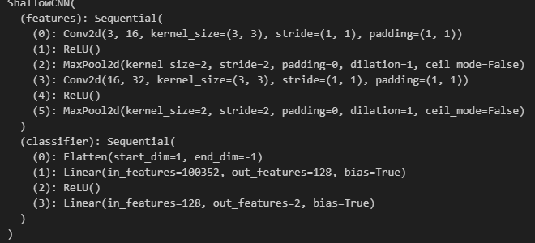
Baseline Architecture - Shallow CNN
Architecture:
2 convolutional layers
ReLU activations
Max pooling
Fully connected classifier
Design motivation:
Simple model to establish a baseline
Limited capacity to reduce overfitting risk
Optimizer: Adam
Learning rate: 1e-3
Epochs: 10
Purpose: Understand the minimal model capacity required for the task

Slide 5
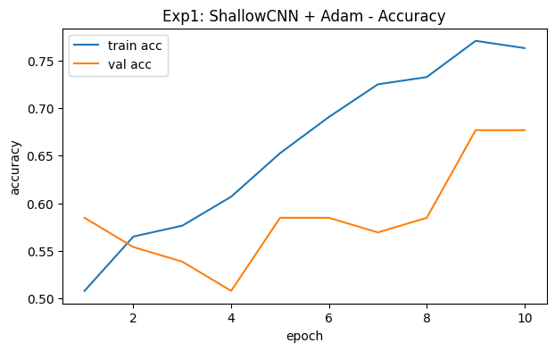
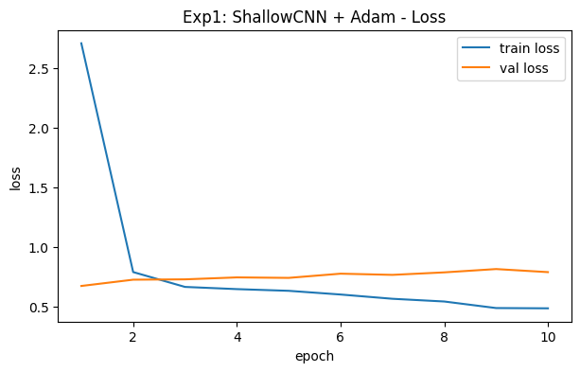
Baseline Results - Shallow CNN
Training behavior
Training loss decreased steadily across epochs
Training accuracy improved consistently
Validation performance
Validation accuracy showed limited improvement and high variance
Validation loss increased gradually after early epochs
Observation
Growing gap between training and validation loss
Validation accuracy improved only marginally at later epochs
Conclusion
The shallow CNN shows early signs of overfitting
Limited generalization suggests the need
for stronger regularization or increased model capacity

Slide 6
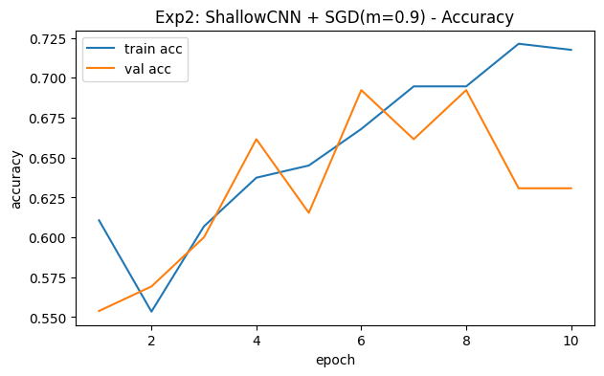
Optimizer Comparison - Adam vs. SGD
Optimizers evaluated:
  Adam
  SGD with momentum (0.9)
Adam:
  Fast and stable convergence
  Smooth training curves
  Higher and more consistent validation accuracy
SGD with momentum:
  Slower and less stable convergence
  Highly sensitive to learning rate
  Large fluctuations in validation performance
Conclusion:
Adam was more suitable for this small dataset
and limited training regime
SGD exhibits unstable validation performance across epochs.

Slide 7
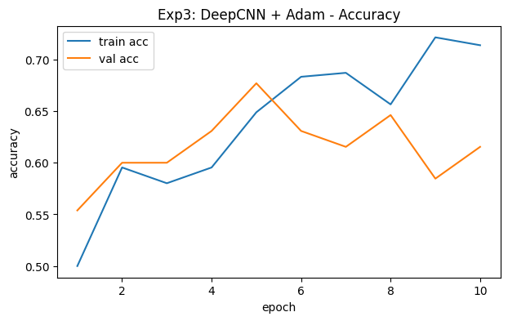
Architecture Comparison –
Shallow vs. Deep CNN
Shallow CNN:
  Lower representational capacity
  High training accuracy
  Clear overfitting behavior
Deep CNN:
  Increased depth and capacity
  Slightly improved validation accuracy
  Reduced train–validation gap
Key observation:
Deeper architecture improved generalization without significantly increasing overfitting
Conclusion:
Increasing model depth led to more meaningful feature representations
Depth helped the model capture more complex visual patterns.

Slide 8
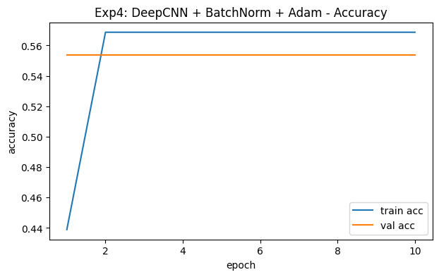
Batch Normalization - Analysis
LR = 1e-3:
BatchNorm added to the Deep CNN and trained with Adam
LR = 1e-3:
  Highly unstable training in early epochs
  Very high initial training loss
  Model collapsed to majority-class prediction
  Flat validation accuracy (~55%)
LR = 1e-4:
  Improved training stability
  Convergence without collapse
  Validation accuracy comparable to non-BN model (~79%)
Conclusion:
Batch normalization was highly sensitive to learning rate and did not improve generalization on this small dataset
BN affected optimization dynamics but provided no clear benefit in validation performance.

Slide 9
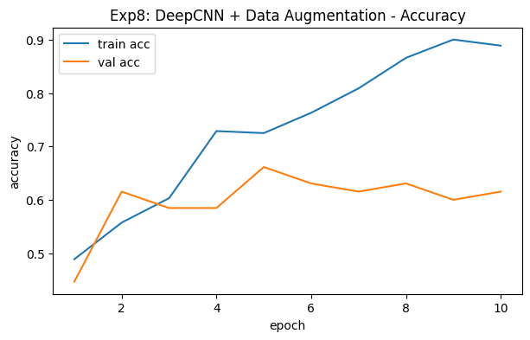
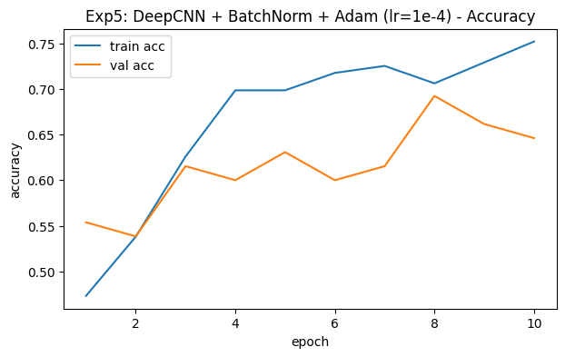
Regularization Techniques
Weight Decay (L2):
Reduced overfitting
Improved validation stability
Slight improvement in generalization
Dropout:
Lower training accuracy
More stable validation performance
Comparable validation accuracy to the non-regularized model
Data Augmentation:
Insight:
Regularization was essential for improving training stability and generalization on a small dataset,
though no single method completely eliminated overfitting.
Strong impact on training dynamics
Training accuracy decreased
Validation accuracy increased compared to the non-augmented setting
Did not yield the best validation accuracy overall

Slide 10
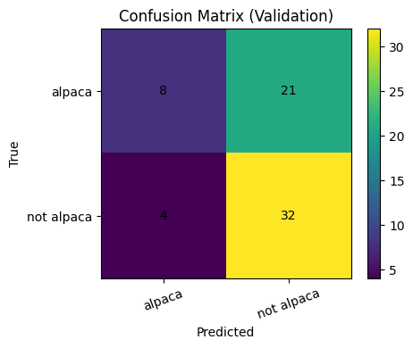
Error Analysis :
Confusion Matrix & Examples
Confusion Matrix (Validation):
  Most samples are classified correctly
  Errors occur mainly between visually similar cases

Slide 11
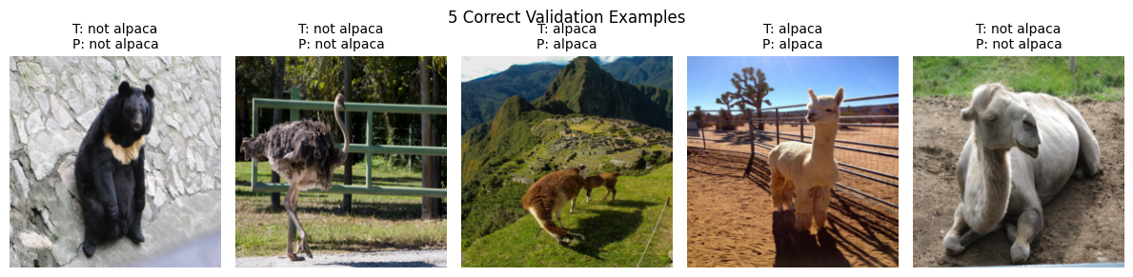
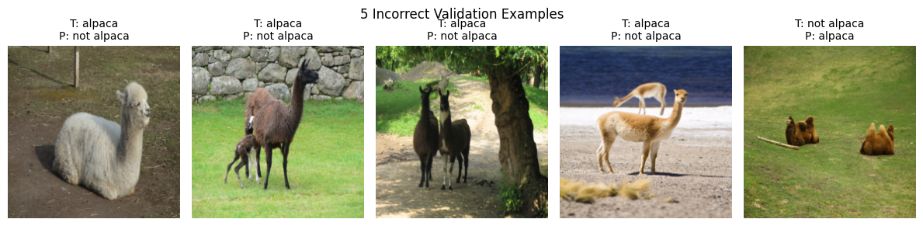
Correct Predictions:
  Clear visual cues
  Distinct object appearance
  Simple background and lighting
Incorrect Predictions:
  Ambiguous images
  Complex backgrounds
  Partial occlusion or unusual viewpoints

Slide 12
Summary & Conclusions :
Training from Scratch
Training CNNs from scratch on a small dataset is highly prone to overfitting
Increasing model depth improved feature representation and reduced overfitting
Adam optimizer provided faster and more stable convergence than SGD
Batch normalization affected training dynamics but did not improve generalization
Regularization was critical for success:
Weight decay and dropout improved stability
Data augmentation yielded the best validation performance
Key takeaway:
Generalization, not training accuracy, is the main challenge in small-data regimes

Slide 13
Part 1:
Final Reflection - Training from Scratch
Training CNNs from scratch on a small dataset is challenging and highly prone to overfitting
Architectural improvements alone are insufficient without proper regularization
Data augmentation proved to be the most effective technique for improving generalization
These findings highlight the limitations of training from scratch in small-data regimes

Slide 14
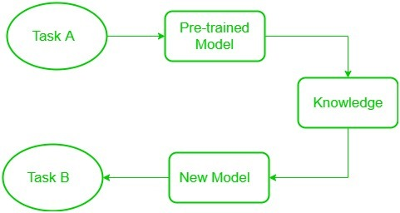
Part 2 :
Transfer Learning for Image Classification
Goal:
Design and train a CNN from scratch on an external dataset (CIFAR-10),
then apply transfer learning to a small target dataset
and compare the results with training from scratch.
Focus on:
  Speed of convergence
  Final accuracy
  Generalization behavior
  Task A: CIFAR-10
  Task B: Target Dataset (Alpaca vs Not Alpaca)

Slide 15
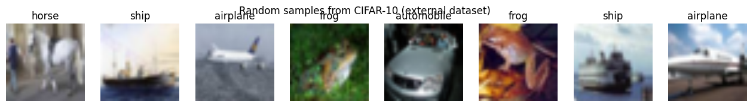
External Dataset and Pretraining (CIFAR-10)
External dataset: CIFAR-10
60,000 natural images, 10 object classes
Used to pretrain the CNN before the target task
Images resized to match the network input size
Goal: learn general visual features, not task-specific labels

Slide 16
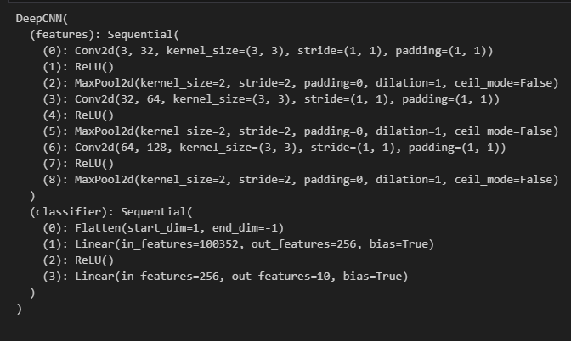
CNN Architecture and Pretraining Setup
Architecture: DeepCNN (3 conv blocks + classifier head)
Input: 224×224 RGB
Pretraining task: CIFAR-10 (10 classes, subset)
Optimizer: Adam, learning rate 1e-3
Training: 2 epochs (CPU constraint)
Output: saved checkpoint pretrained_cifar10.pth

Slide 17
Pretraining Results on CIFAR-10
Training on CIFAR-10 (subset, 2 epochs due to CPU constraints)
Initial improvement in training and validation performance
Model learns transferable low-level visual features
Pretraining goal achieved (feature initialization)

Slide 18
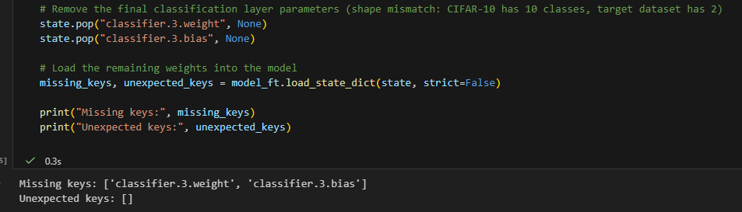
Transfer Learning Setup: Loading Pretrained Weights
Initialize the same CNN architecture for the target dataset
Load pretrained weights from CIFAR-10
Replace the final classification layer:
  CIFAR-10: 10 classes
  Target dataset: 2 classes
Pretrained convolutional layers reused as initialization for transfer learning

Slide 19
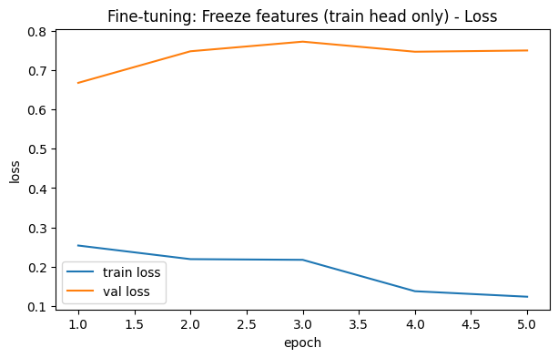
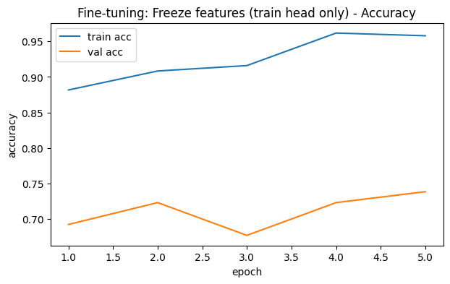
Fine-Tuning Strategy: Training the Classifier Head
Pretrained convolutional layers frozen
Only the classification head is trained
Learning rate: 1e-3
Rapid initial improvement, followed by mild overfitting
Achieved the best validation accuracy, but with some instability across epochs

Slide 20
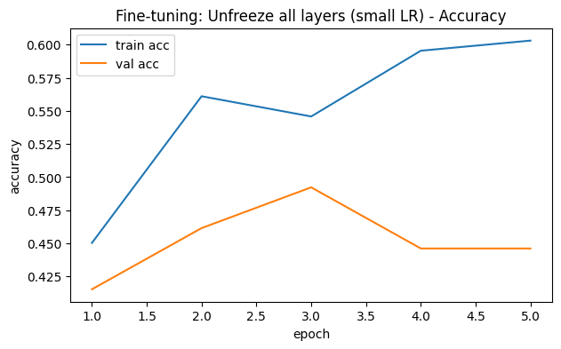
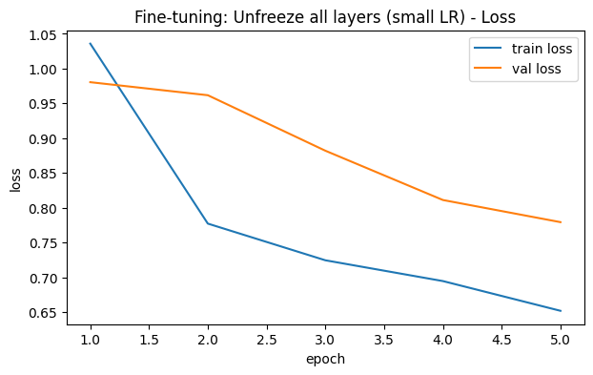
Fine-Tuning Strategy: Unfreezing All Layers
Independent experiment starting from CIFAR-10 pretrained weights
Entire network unfrozen
Fine-tuning performed with a smaller learning rate (1e-4)
Weight decay used for regularization
Training accuracy increased (up to ~0.60)
Validation accuracy peaked early (epoch 3) and then decreased

Slide 21
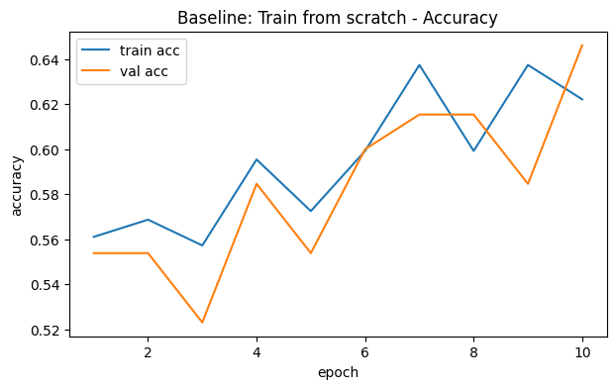
Comparison: Transfer Learning vs Training from Scratch
• Same CNN architecture and preprocessing for all experiments
• Transfer learning (freeze head only):
  Faster convergence
  More reliable early training dynamics
  Better generalization behavior on a small dataset
• Transfer learning (unfreeze all layers):
  Fast convergence
  Overfitting observed
• Training from scratch:
  Slower convergence
  Comparable but less stable validation performance
• Overall, transfer learning provides a more reliable training strategy
when the target dataset is small

Slide 22
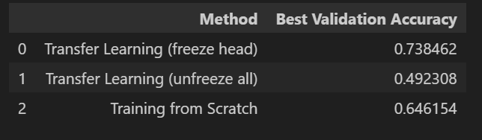
Considerations and Limitations
Small target dataset (~300 images) limits generalization
Validation accuracy shows variability across runs
CPU-based training constrained number of epochs and experiments
Full fine-tuning increases risk of overfitting on small datasets
Results depend on data split and preprocessing choices

Slide 23
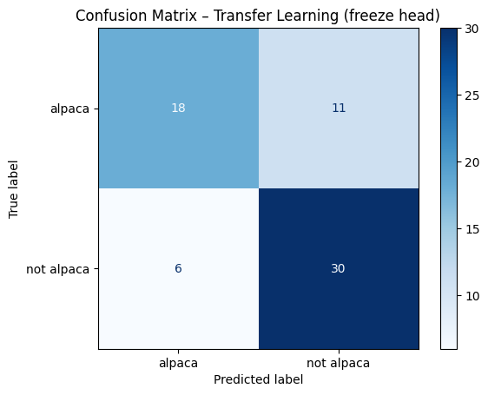
Part 2- Conclusions and Final Reflection
Transfer learning is effective when the target dataset is small
Pretraining on CIFAR-10 enabled faster convergence and more reliable early validation performance
Training only the classifier head provided the best generalization
Full fine-tuning led to overfitting on the target dataset
Experimental results highlight the importance of choosing an appropriate fine-tuning strategy

Slide 24
Part 3:
Transfer Learning with a Pretrained Network (ResNet50)
Goal:
Use a deep pretrained network (ResNet50 trained on ImageNet) and adapt it to a small target dataset.
Evaluate how freezing and fine-tuning different layers affects performance compared to earlier approaches.
Focus on:
Effect of freezing vs fine-tuning pretrained layers
Training stability and convergence speed
Final accuracy and generalization on a small dataset
Comparison with:
  Custom CNN (Part 1)
  CNN with transfer learning (Part 2)

Slide 25
Dataset & Preprocessing
Target task: Binary classification (alpaca vs not alpaca)
Dataset size: 327 images, split 80/20 (seeded)
Input setup for ResNet50:
  Resize to 224×224
  Normalize using ImageNet mean/std
Regularization: data augmentation on train only
  flip, rotation, color jitter

Slide 26
Model Adaptation & Freezing Strategy
ResNet50 pretrained on ImageNet
Final classification layer replaced to match 2 classes
Frozen backbone - only the classification head is trainable
Trainable parameters: ~4K out of 23M (~0.02%)

Slide 27
Adapting ResNet50
ResNet50 pretrained on ImageNet
Final classification layer replaced for 2 classes
Initial setup:
  Frozen backbone
  Train classification head only
Trainable parameters: ~4K / 23M
Goal: fast and stable adaptation to a small dataset

Slide 28
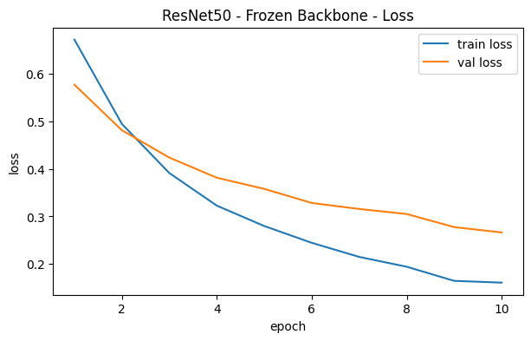
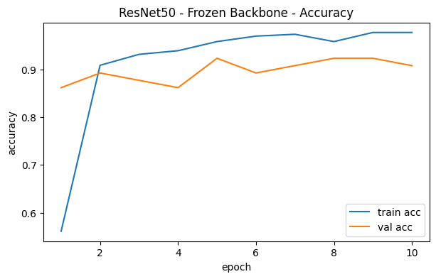
Experiment 1 - Frozen Backbone
Train only the new classifier head
Optimizer: Adam, lr=1e-3, weight_decay=1e-4
Fast convergence, stable training
Validation accuracy: ~0.90–0.92

Slide 29
Experiment 2 - Fine-Tuning layer4
Unfreeze layer4 + classification head
Earlier layers remain frozen
Goal: adapt high-level features to the target task
More trainable parameters than Experiment 1, but still controlled

Slide 30
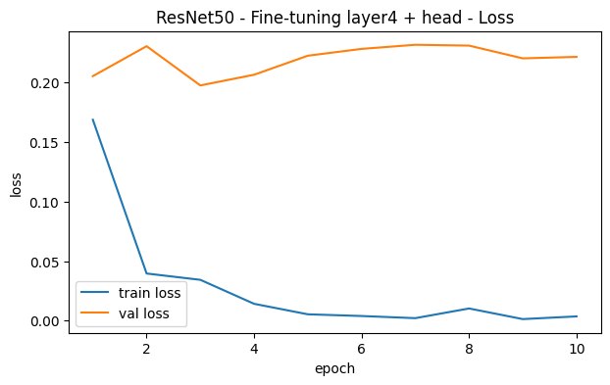
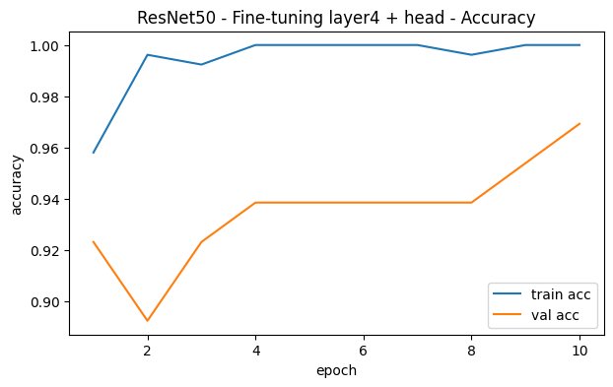
Experiment 2 - Fine-Tuning layer4 + Head
Unfreeze layer4 and classification head
Different learning rates:
layer4: 1e-4
head: 1e-3
Higher flexibility than frozen setup
Best validation accuracy: ~0.97

Slide 31
Frozen vs Fine-Tuned ResNet50
Setup | Best Val Acc | Stability | Notes
Frozen backbone | ~0.92 | Very stable | Fast convergence
Fine-tuned layer4 | ~0.97 | Stable | Better adaptation

Slide 32
Part 3 - Conclusions
Transfer learning with ResNet50 significantly outperforms training a CNN from scratch on a small dataset.
Training only the classification head already achieves strong performance.
Fine-tuning the last ResNet block further improves validation accuracy.
Carefully controlling learning rates is crucial for stable fine-tuning.
Fine-tuning high-level features leads to better adaptation without sacrificing stability.

Slide 33
Final Reflection
Architectural Choices
The most important architectural factor was choosing a model with enough capacity without overfitting the small dataset.
Shallow CNNs were too limited and showed clear overfitting behavior.
Deeper CNNs improved feature extraction and slightly reduced the gap between training and validation performance.
The biggest improvement came from using pretrained architectures, especially ResNet50, which provided strong feature representations from the start.
In this project, using a well-established pretrained model mattered more than designing a complex custom architecture.

Slide 34
Optimization Strategies
Adam was the most reliable optimizer across all experiments.
It converged faster and produced more stable validation results than SGD with momentum.
Learning rate selection had a strong impact on training stability, especially when using batch normalization or fine-tuning pretrained layers.
Batch normalization did not improve generalization and was very sensitive to the learning rate.
Regularization techniques were essential, particularly weight decay, dropout, and data augmentation.

Slide 35
Regularization and Generalization
Overfitting was the main challenge due to the small dataset size.
Weight decay and dropout helped stabilize training but did not fully solve overfitting.
Data augmentation had the strongest positive effect on validation performance.
Although augmentation reduced training accuracy, it improved generalization, which was the main goal.
These results emphasize that validation performance is more important than high training accuracy.

Slide 36
When Transfer Learning Helped
Transfer learning was very effective for this task.
Initializing models with pretrained weights led to faster convergence and more stable training.
Training only the classifier head gave better generalization than fully fine-tuning the network.
Full fine-tuning often caused overfitting when the dataset was small.
The best results were achieved using ResNet50 pretrained on ImageNet, especially when fine-tuning only the last block.

Slide 37
What I Would Do Differently
With more time, I would explore additional fine-tuning strategies, such as gradual unfreezing.
A more systematic hyperparameter search could further improve stability and performance.
With more data, full fine-tuning would likely become more effective and less prone to overfitting.
More detailed error analysis could help identify specific failure cases and guide further improvements.

